Slide 1
Week 02, Day 03
Intro to JavaScript
CodeSLO 2018

Slide 2

Welcome to Intro to JavaScript
JavaScript is the heart of modern web development. Whether or not you succeed in your attempt to become a web developer will, in the end, depend on your ability to understand and write JavaScript code.

Slide 3
But what IS JavaScript?
JavaScript is the programming language of the web. It is the only programming language that browsers currently understand.
JavaScript is the most popular programming language in the world. This is due less to the language itself and more to the importance of the Internet and web-based applications
JavaScript started out as a browser-only language, but it has moved beyond that. Now, JavaScript can be used on the server, in desktop programs, and in mobile applications.

Slide 4
Hello World!
Traditionally, the first program you write in any new language should be Hello World. Let’s write ours!
To get started, let’s create a file in VS Code called “hello-world.js”

Slide 5
Hello World, v1.0
In VS Code, create a new file called HelloWorld.js
In that file, enter the following text:
console.log("Hello World!");

Slide 6
Demo: Testing HelloWorld.js
Save the file
Open VS Code’s built in terminal using ctrl + tilde (~)
In VS Code, test the code using CodeRunner (ctrl + alt + n)

Slide 7
Exercise: Test HelloWorld.js on your system
Same steps!
Save the file
Open VS Code’s built in terminal using ctrl + tilde (~)
In VS Code, test the code using CodeRunner (ctrl + alt + n)

Slide 8
The JavaScript Console
We have two objectives in this class.
The first is to prepare you for the Fullstack Academy admittance test. If you decide not to go on to Fullstack, we’d prefer it not be because you can’t pass their test.
The second is to teach you to build working web applications. To that end, we’ll show you how to use JavaScript in the DOM. More on that, later.
We’ll also be working in the JavaScript console. This is where we’ll work on most of our coding puzzles and challenges.

Slide 9
JavaScript Variables

Slide 10
Variables
Variables are essentially a quick way to access data. They have a name that you and the computer agree can be used to access that data.
For example, if you wanted to store the sales tax rate for California in a variable for use in an eCommerce application, you might decide to name it CaTaxRate. Then, you’d declare the variable and assign it a value like this:
const caTaxRate = 7.25;

Slide 11
Declaring Variables
In JavaScript, variables can be created in two ways: with the let keyword and the const keyword.
let is used in cases where the variable may be reassigned a different value.
const is used in cases where the variable will always have the same value. JavaScript won’t allow you to reassign a const variable.
Then you just assign the variable a name. There are a few rules about this. For instance, you can’t start a variable with a number and they can’t include spaces or hyphens.

Slide 12
General Rules for Naming Variables
Names can contain letters, digits, underscores, and dollar signs.
Names must begin with a letter
Names can also begin with $ and _
Names are case sensitive (a and A are different variables)
Reserved words (like JavaScript keywords) cannot be used as names

Slide 13
camelCase
Multi-word variable names are written using something called Camel Case.
Camel Case examples:
let thisVariableIsInCamelCase;
const goodVariableName;
let thisIsWayTooLongButStillInCamelCase;

Slide 14
Example Variable Names
let codingGroupName = "CodeSLO";
let userFirstName = "Jose";
let applePrice = 0.49;
const caTaxRate = 7.25;
const pi = 3.14159265359;

Slide 15
JavaScript comments
In the coming slides, we have a lot of code examples.
When we have something to say about a code example, we use a JavaScript Comment to say it.
In JavaScript, you create an inline comment by preceding it with //
// this is a comment
Comments can be read by humans, but are ignored by interpreters.

Slide 16
Using Variables
Referring to a variable by its name will access the data stored in that variable.
Example:
let userFirstName = "Jose";
console.log(userFirstName); // logs "Jose"
const pi = 3.14159265359;
console.log(pi); // logs 3.14159265359

Slide 17
Two Types of Variables
Variables can be classified by their data type.
For now, we’ll deal with two of those data types: strings and numbers.
Strings are for holding text. When string variables are declared, they are enclosed by either double or single quotes.
Numbers are (surprise) numerical data. When number variables are declared, no quotations are used.

Slide 18
Quiz: Which Data-Type?
let codingGroupName = "CodeSLO";
const caTaxRate = 7.25;
let applePrice = 0.49;
let userFirstName = 'Jose';

Slide 19
Exercise: Declare Variables
Create a new file called variables.js
Declare five different variables and assign them either numbers or strings as values. Be sure to declare variables of either type.
Use a mixture of the let and const keywords.
Save your file
Does VS Code show you any errors?

Slide 20
console.log()
Console.log is a built-in JavaScript method. It writes stuff to the console, a place where we can get feedback from the computer about our programs.
A method is a type of function, which are the “workers” of JavaScript. Functions perform actions.
If variables are the nouns of the JavaScript language, then functions and methods are its verbs.

Slide 21
How to use console.log
Console.log is often used for testing and debugging.
Let’s say that we had a variable called ‘pizza’ and we wanted to check the value of that variable. That might go like this:
let pizza = "salami,chicken,and olive";
console.log(pizza);
Notice the semicolon. In JavaScript, statements are terminated by a semicolon.

Slide 22
Exercise: Log your variables
In your variables.js file, create a console.log statement for each of your variables.
Remember the format of console.log: console.log(variableName);
Don’t forget your semicolons!!!
Save your file
Run your code using CodeRunner (ctrl + alt + n)
What does it do? You should see the values of each of your variables displayed in the console.

Slide 23
Break & Check In
Back in 5 minutes

Slide 24
Operations

Slide 25
Operations
JavaScript can perform mathematical operations on numbers.
console.log(5+2); // logs 7
console.log(16-1); // logs 15
console.log(5 * 2); // logs 10
console.log(10 / 2); // logs 5

Slide 26
Exercise: Try some operations
Create a new file called operations.js
Use console.log to do some math. Use addition, subtraction, multiplication, and division.
Try using longer formulas that use more than two numbers and more than one operation.
Run your program with CodeRunner. ctrl + alt + n
Have fun! You’re actually writing a simple JavaScript program.

Slide 27
The Modulus
One unusual type of operator is the modulus.
The modulus attempts to divide one number into another, but it returns only the remainder of that equation. This is more useful than you might think.
The modulus uses the % symbol.
console.log(5 % 2); // logs 1
console.log(14 % 5); // logs 4

Slide 28
Exercise: The Modulus
let modulusTest01 = 5 % 2;
let modulusTest02 = 10 % 2;
let modulusTest03 = 15 % 10;
let modulusTest04 = 100 % 99;
let modulusTest05 = 6 % 4;
let modulusTest06 = 16 % 6;
What do these work out to be? Use console.log to find out.

Slide 29
String Concatenation
String concatenation is basically “adding” two strings together.
console.log("Hello" + " " + "World"); // logs "Hello World"
console.log("Hello "+"World"); // also logs "Hello World"
Pop Quiz: Why do both of those statements log the same thing? What’s going on in that first statement?

Slide 30
Exercise: Hello World v2.0
Create a new file called hello-world-2.js
Create a new variable called firstString with a value of “Hello”
Create a new variable called secondString with a value of “World”
Create a new variable called sentence that concatenates firstString, secondString, and a space character.
Console.log sentence.
Save your file.
Run your program with CodeRunner (ctrl + alt + n)
What did it do?

Slide 31
Functions
Functions are the workhorses of JavaScript. If variables are the nouns of the language, functions are the verbs. They do stuff.
Let’s take a closer look.
The following image is taken from the book Headfirst JavaScript, which is a quality intro for beginners.

Slide 32
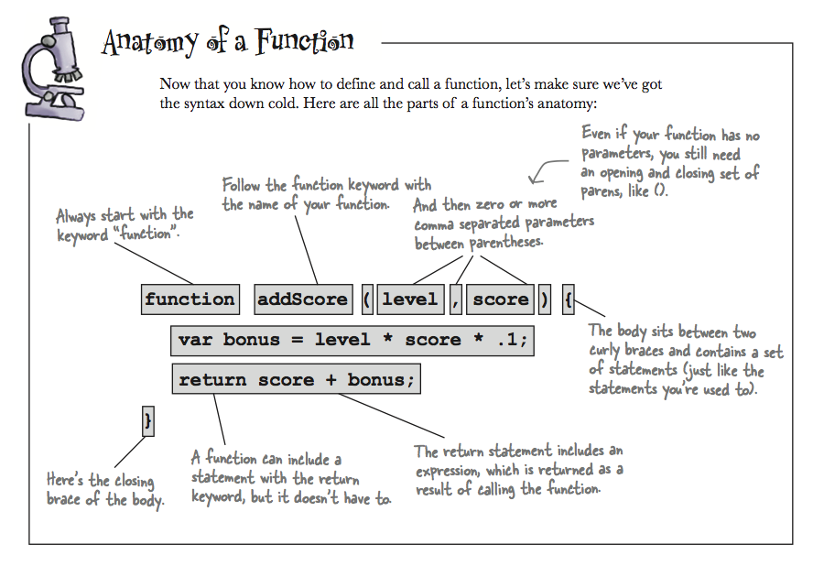

Slide 33
Anatomy of Functions (cont’d)
DEFINE a function:
function nameOfFunction(parameter, anotherParameter) {
let localVariable = parameter + anotherParameter;
return localVariable;
}
CALL a function:
nameOfFunction(myArgument, myOtherArgument);

Slide 34
Getting to Know Functions
JavaScript is a functional programming language. Functions are it’s essential building block.
There are four essential things to understand about functions. They can do work, they can return values, they can accept parameters, and they have their own scope.

Slide 35
Functions can do work
Functions can filter, read, or modify data. They can also change elements of a web page. Sometimes this is the primary thing they do. The function below logs a simple greeting.
function simpleGreeting(){
console.log("Hello from simpleGreeting.");
}

Slide 36
Functions can return values
Sometimes the purpose of a function is to give something back. This is called a return value. The function below returns the value of pi.
function getPi(){
return Math.PI;
}
let pi = getPi(); //pi is now equal to 3.1415...

Slide 37
Functions can take parameters
Sometimes the purpose of a function is to take data from somewhere else (parameters), massage it in some way and return something new. The function below calculates the area of a rectangle based on parameters handed to it.
function getArea(width,length){
return width * length;
}
let photoArea = getArea(5, 7); //photoArea is now 35

Slide 38
Creating functions
Let’s get some practice creating and calling functions.

Slide 39
Exercise: Create a function
Inside your mycode folder, in your folder for this week, create a new file called firstFunction.js
Follow along as we create and call a simple function that multiplies ten times ten.

Slide 40
Exercise: Create more functions
Create a new file called moreFunctions.js
In moreFunctions.js make a variable called sample
Create five different functions. Names firstFunc, secondFunc, etc.
Each function should do two things:
Manipulate sample in some way. IE, add or subtract from it, concatenate it with something, etc.
Log sample to the console.
Call each function in turn.
Did it work?

Slide 41
Questions?

Slide 42
Coming Up
Tomorrow we continue our introduction to JavaScript. We’ll talk about scope, parameters, booleans, control-flow, and more.
If you want to work ahead on JavaScript, try skipping to the JavaScript Algorithms and Data Structures section of Free Code Camp.
Practice practice practice. This class is going to keep moving faster. If you want to keep up, it’s not enough just to code in class. You should be looking for additional time during your day to practice making JavaScript functions, working with operators, etc.

Slide 43
Code On!

